Slide 1
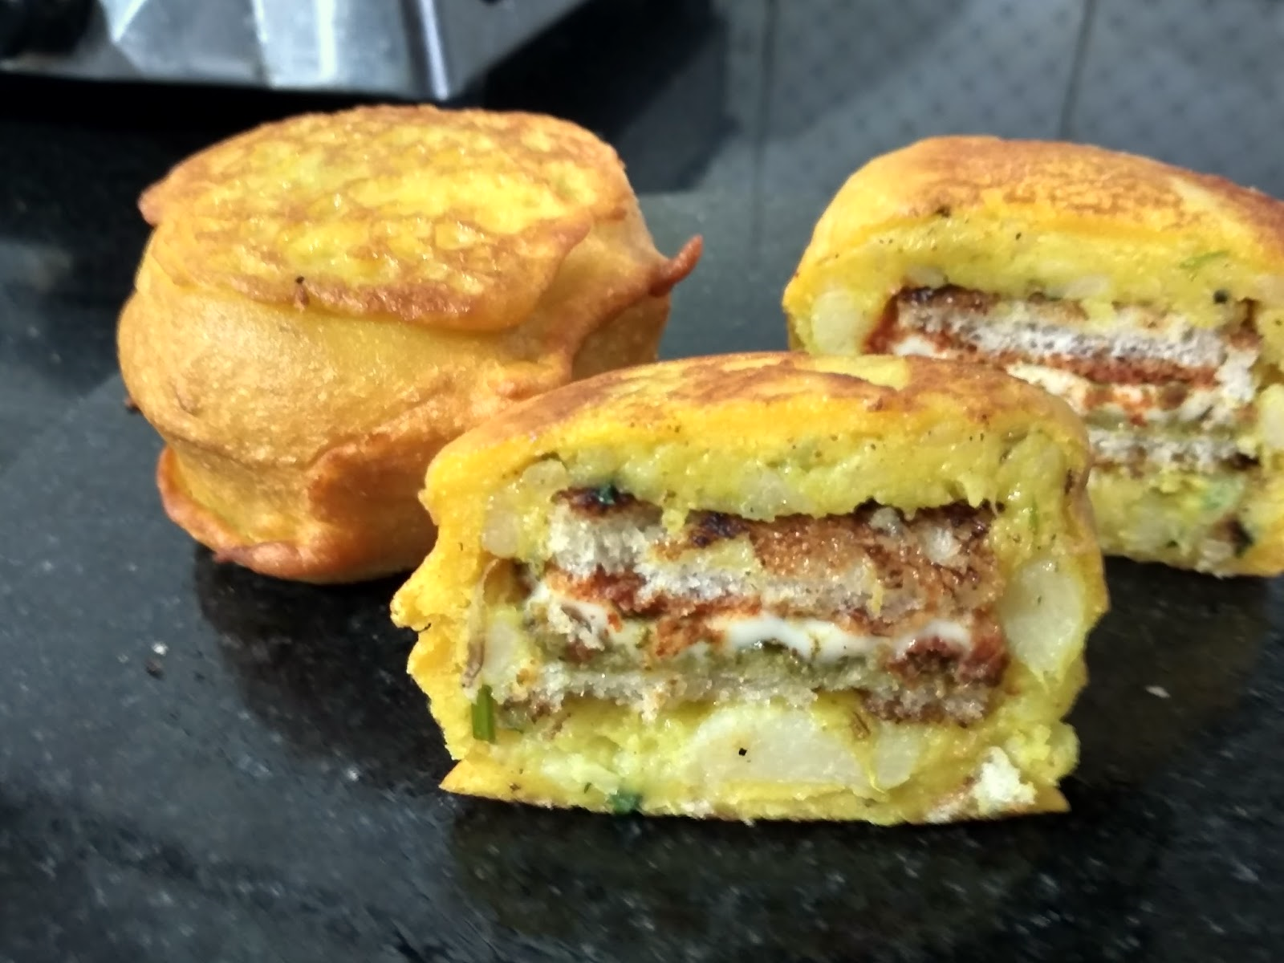
CASE STUDY-VADA PAV (A study for the new Vada pav shop in the Shivaji Nagar, Pune)
PRESENTED BY –Surendra Upadhyay

Slide 2
Introduction
Problem -
A man wants to open a Wada Pav Shop near Shivaji Nagar in Pune. He has got allocation where there are other 4 more Wada pav shops. He is not able to understand what will be the strategy to take over his client
Starting a Vada pav outlet does not involve much investment.
The government licensing fee is also very nominal. The raw materials are easily available.
The switching cost, in case the business does not perform well, is also very small. Considering these factors, the threat of new entrants will always be there.
Vada pav has been associated with Mumbai and tourists want to taste the Mumbai Vada pav. KVP has launched different varieties of Vada pav, which has prompted even the locals to try the new addition
Outlets have been opened at places that are usually thronged by locals and tourists
The political environment is also in favor of the product.

Slide 3
A. Pricing

Slide 4
B. Differentiation
Services & Amenities
Outdoor Seating
Home Delivery
Serves Non Veg
Parking Available
e-Wallets Accepted
Social media platform
Instagram
Facebook
What's app order
Just dial
Food blogs WordPress
Delivery
Online delivery
Zomato
Swingy
Food panda
Quick service quality
Payment mode
Cash
BHIM
UPI
G-PAY
Phone Pay
Affordable price with different types of combo
High hygiene with verity of offering
Strong branding and local market deep knowledge

Slide 5
Top -10 Wada pav shop in Shivaji Nagar (IN 5 km area)
Name | Mobile no | Rating (*)/5 | Time | Ambiance | Service | Food | Value of money
Gaedwn vadav pav center | 9766976699 | 3.7 | 9.00am-10.00pm | 3.6 | 3.6 | 3.8 | 3.8
ROHIT WADEWALA | 8071268303 | 3.6 | 10.00AM -9.00PM | 3.5 | 3.4 | 3.7 | 3.8
JOMBOKING(AHARDUL EXPRESS) | 8007759825 | 4.6 | 9.00am-10.30pm | 4.5 | 4.7 | 4.5 | 4.7
CHOTU KOHLAPURI | 7350842100 | 4.2 | 8.30AM-8.30PM | 4.1 | 4.3 | 4.1 | 4.3
BHARTI WADEWALA | 9970623858 | 3.7 | 7.00AM-10PM | 3.6 | 3.8 | 3.6 | 3.8
PRABHA VISHRANTI | 9923278122 | 4.15 | 8.30AM-12.00PM 4.30PM-7.30PM | 4.1 | 4.1 | 4.3 | 4.1
JOSHI WADEWALE | 8805124997 | 3.6 | 7.00AM-10.00PM | 3.5 | 3.7 | 3.5 | 3.7
THE WADAPAV CEFE |  | 4 | 11.00AM-11.00PM | 3.9 | 4.1 | 3.9 | 4.1
GOLI VADA PAV | 9921054090 | 3.6 | 8.00AM-9.30PM | 3.6 | 3.6 | 3.6 | 3.6
S KUMAR WAEWALA | 9730318559 | 4.2 | 8.00AM-9.00PM | 4.2 | 4.2 | 4.2 | 4.2

Slide 6
C. Competitor’s analysis
VRIO Analysis
Resources/Capabilities | Value | Rarity | Imitability | Organization | Sustainable Competitive Advantage
Business Model | Yes | No | Yes | Yes | Competitive Advantage
International Presence | Yes | No | Yes | Yes | Competitive Advantage
Strong brand identity | Yes | No | No | Yes | Competitive Advantage
Innovation | Yes | Yes | Yes | Yes | Competitive Advantage
GOLI WADA PAV
SWOT Analysis
Strengths | Weaknesses | Opportunities | Threats
Strong Market Position. | Lack of Financial and Technical resources | Increase demand of theme parks | Currency devaluation
Innovative Concept. | Devaluation of Mexican Currency. | High Internet penetration | Intense domestic and international competition
Strong business models | Lack of expertise in operating in U.S markets | Increased mobile phone usage
Large Customer base and Geographical Outreach
Porter’s Five Forces Analysis
Threat of New Entrants | Threat of Substitution | Competitive Rivalry | Bargaining Power of Supplier | Bargaining Power of Buyer
Moderate | High | Intense | Low | High
Requirement of large amount of Capital. | Presence of large number of indirect competitors. | Presence of large number of direct and indirect competitors. | Inter-related benefits of the supplier and the firm. | Presence of large number of direct and indirect competitors.
Presence of number of competitors. | Changing consumer preferences. |  |  | Changing consumer preferences.
High growth potential.

Slide 7
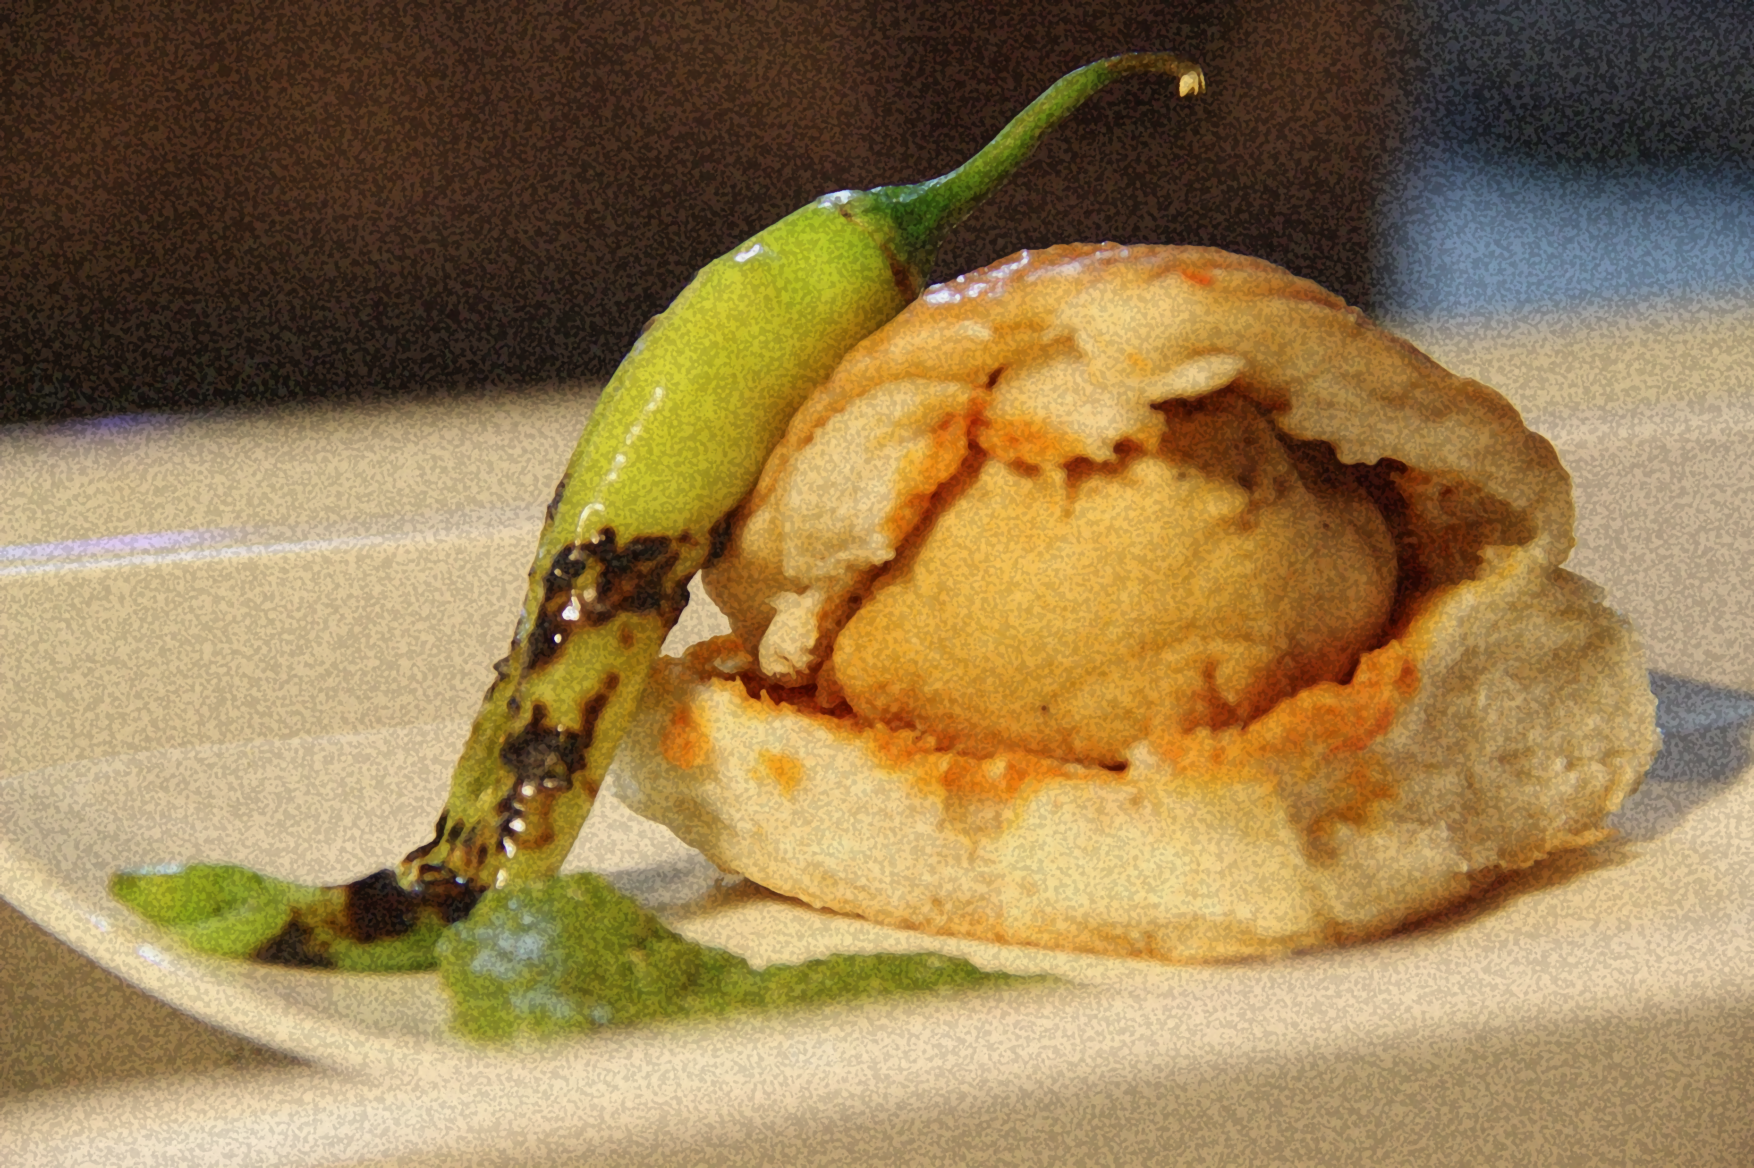
D. Positioning
A good quality product with different verity
Standard row material and fresh food for customers
Middle and low income group people
Mainly Student, couples, employees
Clean and hygienic branded Vada-pav
Low price with best quality compare to others
Best Services & Amenities compare to others

Slide 8

THANK YOU

